Slide 1

What’s in a Name?
Hello, my name is …
Gabrielle Salamanca

Slide 2
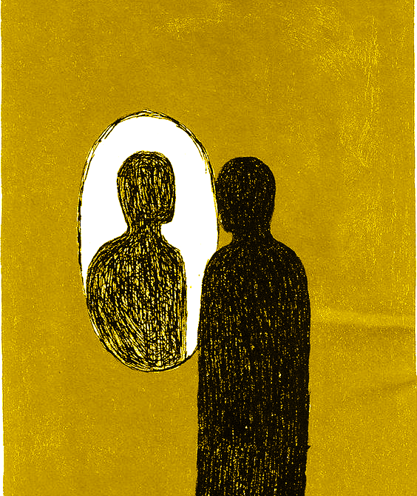
It’s you!
Your Name
Despite
everything
Identity
Family
Culture
Gender
Define: Examples
Email Swap
Numbers
it’s
still
you

Slide 3
1.
The Dataset
Rnames

Slide 4
Are Emily and Greg More Employable than Lakisha and Jamal?

Slide 5
About the Data
Vincent Arel-Bundock’s Github projects
R datasets
4870 rows x 23 columns
Applicants’ resumes
Type of job
Job requirements

Slide 6
The Origins
The National Bureau of Economic Research
Working Papers
Are Emily and Greg More Employable than Lakisha and Jamal? A Field Experiment on Labor Market Discrimination
Marianne Bertrand
Sendhil Mullainathan

Slide 7
The Experiment
Send 4,870 fictitious resumes to job adverts
Randomly assigned a name
Caucasian or African-American
Which ones got a call back

Slide 8
Was the name the main reason for not receiving a call back, or were there other factors affecting it?

Slide 9
Goal: Classification
Response variable
Call back
Yes/No
Find a model that can provide the most accurate prediction

Slide 10
Data Visualization

Slide 11
Resume Names
X | name | gender | ethnicity | quality | call | city | . . .
1 | Allison | female | cauc | low | no | chicago | . . .
2 | Kristen | female | cauc | high | no | chicago | . . .
3 | Lakisha | female | afam | low | no | chicago | . . .
4 | Latonya | female | afam | high | no | chicago | . . .
5 | Carrie | female | cauc | high | no | chicago | . . .
6 | Jay | male | cauc | low | no | chicago | . . .
. . . | . . . | . . . | . . . | . . . | . . . | . . . | . . .

Slide 12
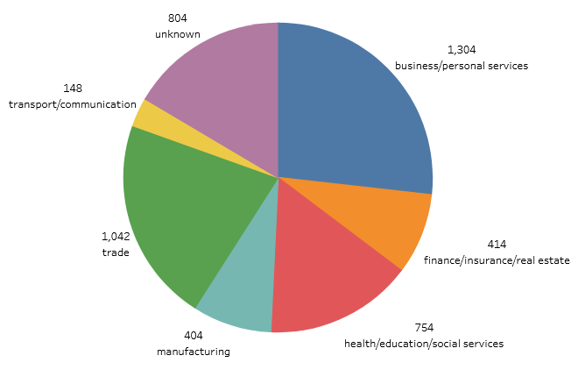
What industries were the jobs offered in?

Slide 13
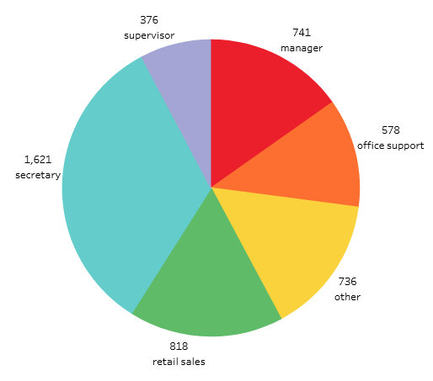
What were the offered positions?

Slide 14
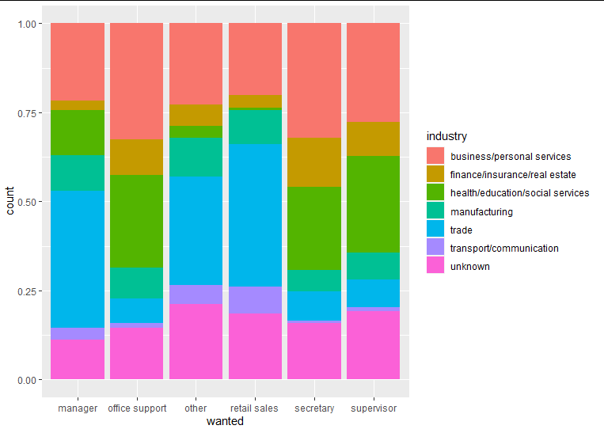
Positions in terms of Industry

Slide 15
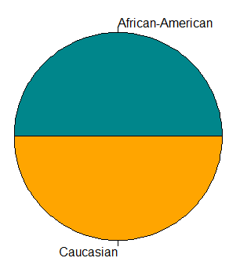
Ethnicity: Caucasian vs African-American
4,780 applicants
2,435 Caucasian
2,435 African-American

Slide 16
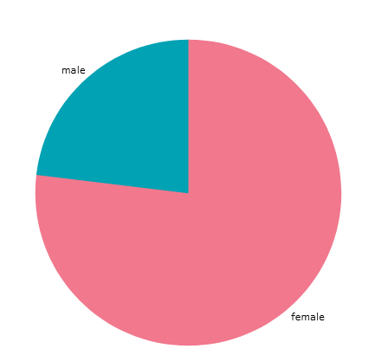
Gender: ♀ vs ♂
4,870 applicants
3,746 female
1,124 male

Slide 17
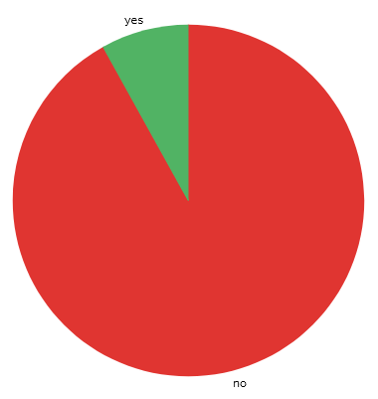
Call back: Yes vs No
4,870 applicants
4478 ‘no’s
392 ‘yes’s
>

Slide 18
2.
Cleaning and Reorganizing
Rnames → Names

Slide 19
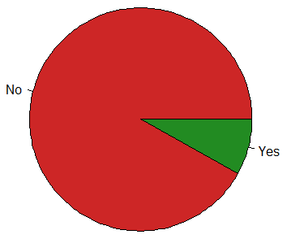
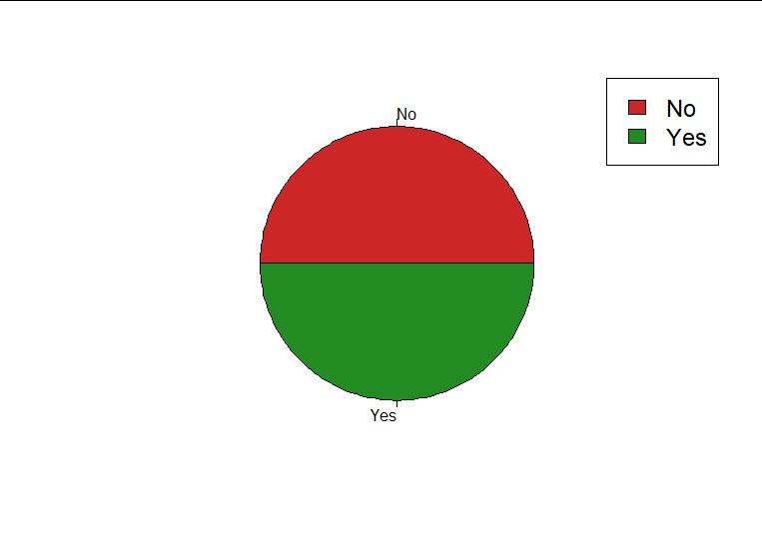
Downsampling
Most important variable
Call back
Before vs After
4,478 vs 392
392 vs 392
=

Slide 20
Updating Dataset
Newnames
downSample(Rnames, Rnames$call)
Names
Removing variables
subset()
X
Cell number
Name
City
Boston vs Chicago
Class
Added by downSample()
Classifying each case

Slide 21
Industry - Wanted Removal?
Originally excluded due to “missing values”
unknown/other
During further testing
Inclusion of Industry - Wanted
Accuracy boosted (in some cases)

Slide 22
3.
Methods
What have I tried?

Slide 23
GLM Fitting
Splitting the Data
80% training
20% test
summary()
Finding the most significant variables
Use a variation of those variables to find the best fit

Slide 24
Without Industry-Wanted Vars
Accuracy
55% < y < 65%
Best fit
63.69427%
glm.fit1
Variables
Ethnicity
Experience
Special
Reqeduc

Slide 25
With Industry-Wanted Vars
Accuracy
50% < y < 65%
Best fit
63.69427%
glm.fit5
glm.fit7
Variables
Ethnicity (5, 7)
Experience (5, 7)
Special (5, 7)
Reqeduc (5, 7)
Honors (5, 7)
Reqcomp (5, 7)
Requirements (7)
Industry (5, 7)

Slide 26
The Methods
Best Subset Selection
Criterion Cross-Validation
LDA
QDA
KNN
Ridge Regression
LASSO

Slide 27
The Fits Being Used
glm.fit1
No Industry var
58.59873%
glm.fit5
Industry var
62.42038%
 | No | Yes
No | 48 | 30
Yes | 35 | 44
 | No | Yes
No | 54 | 31
Yes | 28 | 44

Slide 28
Subset Selection: Stepwise
Stepwise
Selection of independent vars to be used in final model
Forward
Backward
Mix

Slide 29
Subset Selection: Stepwise
Forward
Model w/ NO predictors
Add one at a time that improves model the most until no further improvement
Backward
Model w/ ALL predictors
Delete one at a time that improves model the most until no further improvement
Mix

Slide 30
Subset Selection: Best
Let’s say we have k independent variables
Considers all possible models with (1,...,k) variables
Chooses best model ∀ size
Best overall model is chosen from those finalists

Slide 31
Cross-Validation
What is it?
Technique to evaluate the performance of a model
Why use it?
Prevent overfitting
Algorithm should not fit too closely or even exactly to its training data
Model only makes accurate predictions/conclusions from training data

Slide 32
Cross-Validation: Criterion
Criterion
Small value = model w/ low test error
Mallow’s Cp
Bayesian Information Criterion
Large value = model w/ low test error
Adjusted R-squared

Slide 33
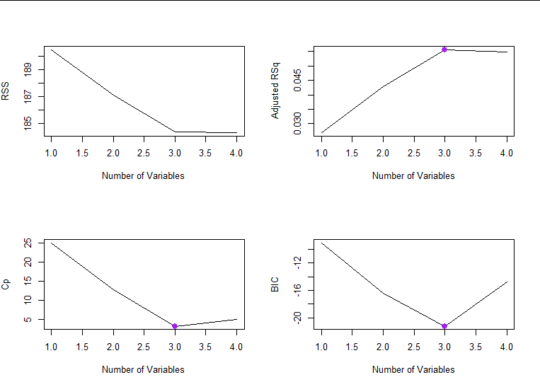
Best Subset Selection: No Industry
When n > 3, RSS is small

Slide 34
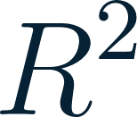

Cross-Validation: No Industry
n = 3
Adjusted
BIC

Slide 35
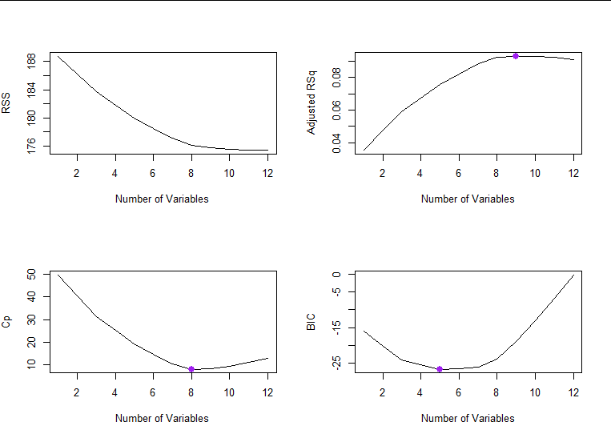
Best Subset Selection: Industry
When n > 10, RSS is small

Slide 36
Cross-Validation: Industry
Adjusted
n = 9
BIC
n = 5
n = 8

Slide 37
Classification Methods
Linear Discriminant Analysis
Quadratic Discriminant Analysis
K Nearest Neighbor
Ridge Regression
LASSO

Slide 38
Method: LDA/QDA
Logistic Regression < LDA/QDA
Stability
Classes of Y are well-separated (Yes/No)
Sample size is small
Predictor vars follow norm distr

Slide 39
LDA/QDA: Differences?
Assumption
The covariances among predictor variables are equal across each class
LDA = strict
QDA = relaxed
Decision boundary
LDA
Linear
QDA
Quadratic

Slide 40
Method: K-Nearest Neighbor
What is it?
Non-parametric supervised learning classifier
Proximity-based predictions
Example: Disease Prediction (disease/healthy)
Let’s say we have a data point
If it’s surrounded by disease points
Predict data point is disease

Slide 41
Classification Methods: No Industry
LDA
58.59873%
QDA
54.77707%
KNN
K = 1
60.50955%
K = 5
64.96815%
 | LDA
 | No | Yes
No | 48 | 30
Yes | 35 | 44
 | QDA
 | No | Yes
No | 51 | 39
Yes | 32 | 35
 | KNN
K = 1 | No | Yes
No | 55 | 34
Yes | 28 | 40
 | KNN
K = 5 | No | Yes
No | 54 | 26
Yes | 29 | 48

Slide 42
Classification Methods: Industry
LDA
62.42038%
QDA
61.78344%
KNN
K = 1
60.50955%
K = 5
64.33121%
 | LDA
 | No | Yes
No | 54 | 31
Yes | 28 | 44
 | QDA
 | No | Yes
No | 60 | 38
Yes | 22 | 37
 | KNN
K = 1 | No | Yes
No | 53 | 33
Yes | 29 | 42
 | KNN
K = 5 | No | Yes
No | 52 | 26
Yes | 30 | 49

Slide 43
Methods: Ridge Regression/LASSO
Ridge Regression
Regularization technique that corrects for overfitting on training data
Least Absolute Shrinkage & Selection Operator
Regularization technique that applies a penalty to prevent overfitting & enhance model accuracy

Slide 44
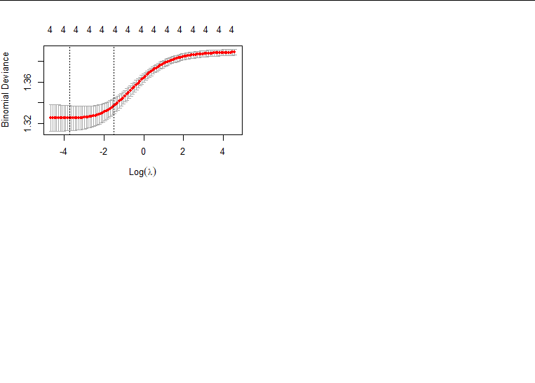
Ridge Regression: No Industry
Accuracy
59.87261%
 | No | Yes
No | 51 | 31
Yes | 32 | 43

Slide 45
Ridge Regression: No Industry
Ridge | Coefficients
Intercept | — 0.8972270
Ethnicity (cauc) | 0.4511977
Experience | 0.0492280
Special (yes) | 0.6192874
Reqeduc (yes) | — 0.1183023

Slide 46
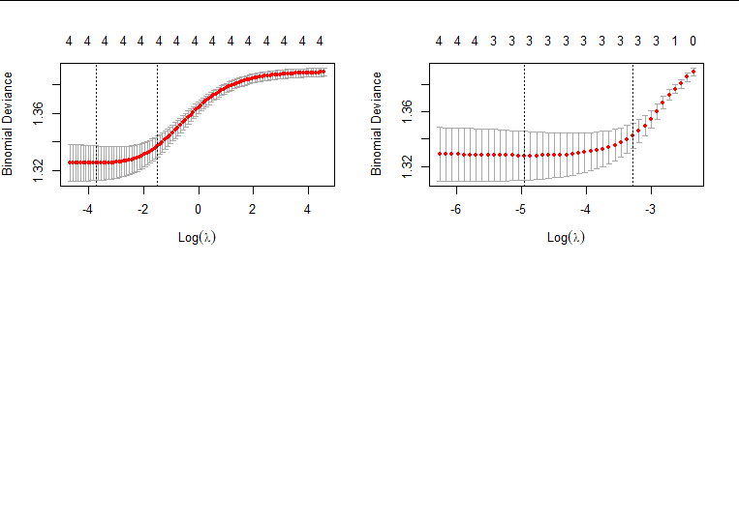
LASSO: No Industry
 | No | Yes
No | 51 | 31
Yes | 32 | 43
Accuracy
59.87261%

Slide 47
LASSO: No Industry
Ridge | Coefficients
Intercept | — 0.84673040
Ethnicity (cauc) | 0.40982207
Experience | 0.04588278
Special (yes) | 0.59580626
Reqeduc (yes) | 0

Slide 48
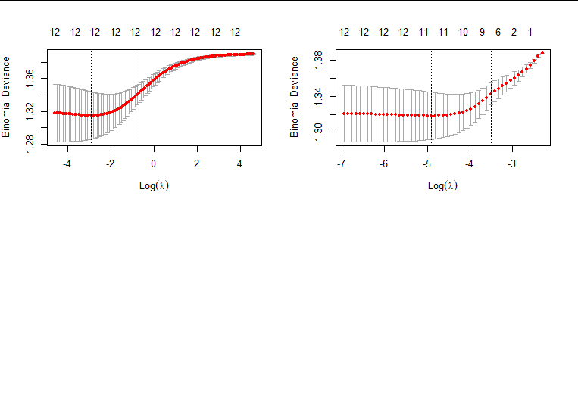
Ridge Regression: Industry
Accuracy
63.69427%
 | No | Yes
No | 55 | 30
Yes | 27 | 45

Slide 49
Ridge Regression: Industry
Ridge | Coefficients
Intercept | — 0.46743944
Ethnicity (cauc) | 0.30914913
Experience | 0.03065452
Special (yes) | 0.56394817
Reqeduc (yes) | — 0.53606360
Honors (yes) | 0.58931603
Ridge | Coefficients
Reqcomp (yes) | — 0.35486429
Industry Finance Insurance Real Estate | — 0.24239488
Industry Health Education Social Services | 0.33985341

Slide 50
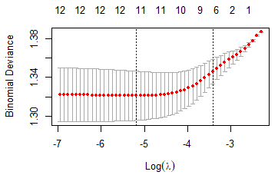
LASSO: Industry
 | No | Yes
No | 55 | 29
Yes | 27 | 46
Accuracy
64.33121%

Slide 51
LASSO: Industry
LASSO | Coefficients
Intercept | — 0.59813958
Ethnicity (cauc) | 0.34333831
Experience | 0.03385181
Special (yes) | 0.69530054
Reqeduc (yes) | — 0.60125455
Honors (yes) | 0.62044904
LASSO | Coefficients
Reqcomp (yes) | — 0.40395699
Industry Finance Insurance Real Estate | — 0.12613050
Industry Health Education Social Services | 0.39792262

Slide 52
Best Classification Accuracy
Without Industry
KNN, K = 5
64.33121%
Same percentage
Industry not as important as expected
64.33121%
KNN, K = 5
LASSO
With Industry

Slide 53
The Rankings: No Industry
KNN, K = 5
64.96815%
KNN, K = 1
60.50955%
Ridge Regression
59.87261%
LASSO
59.87261%
LDA
58.59873%
QDA
54.77707%

Slide 54
The Rankings: Industry
KNN, K = 5
64.33121%
LASSO
64.33121%
Ridge Regression
63.69427%
LDA
62.42038%
QDA
61.78344%
KNN, K = 1
60.50955%

Slide 55
Conclusion
Best Accuracy Rate
KNN, K = 5
With or without industry
Best RSS
With Industry
Improvements?
Minimum variable
Problems in code
Too many lvls
Further explore Best Subset
Find best fits with the limitations

Slide 56
Credits
Special thanks to all the people who made and released these resources for free:
Presentation template by SlidesCarnival
Photographs by Unsplash
Bertrand, M. and Mullainathan, S. (2003). Are Emily and Greg More
Employable than Lakisha and Jamal? A Field Experiment on Labor
Market Discrimination (Working Paper No. 9873). National Bureau of
Economic Research. http://www.nber.org/papers/w9873

Slide 57
Thank you!
😄
Any questions?
Comments?

